Slide 1
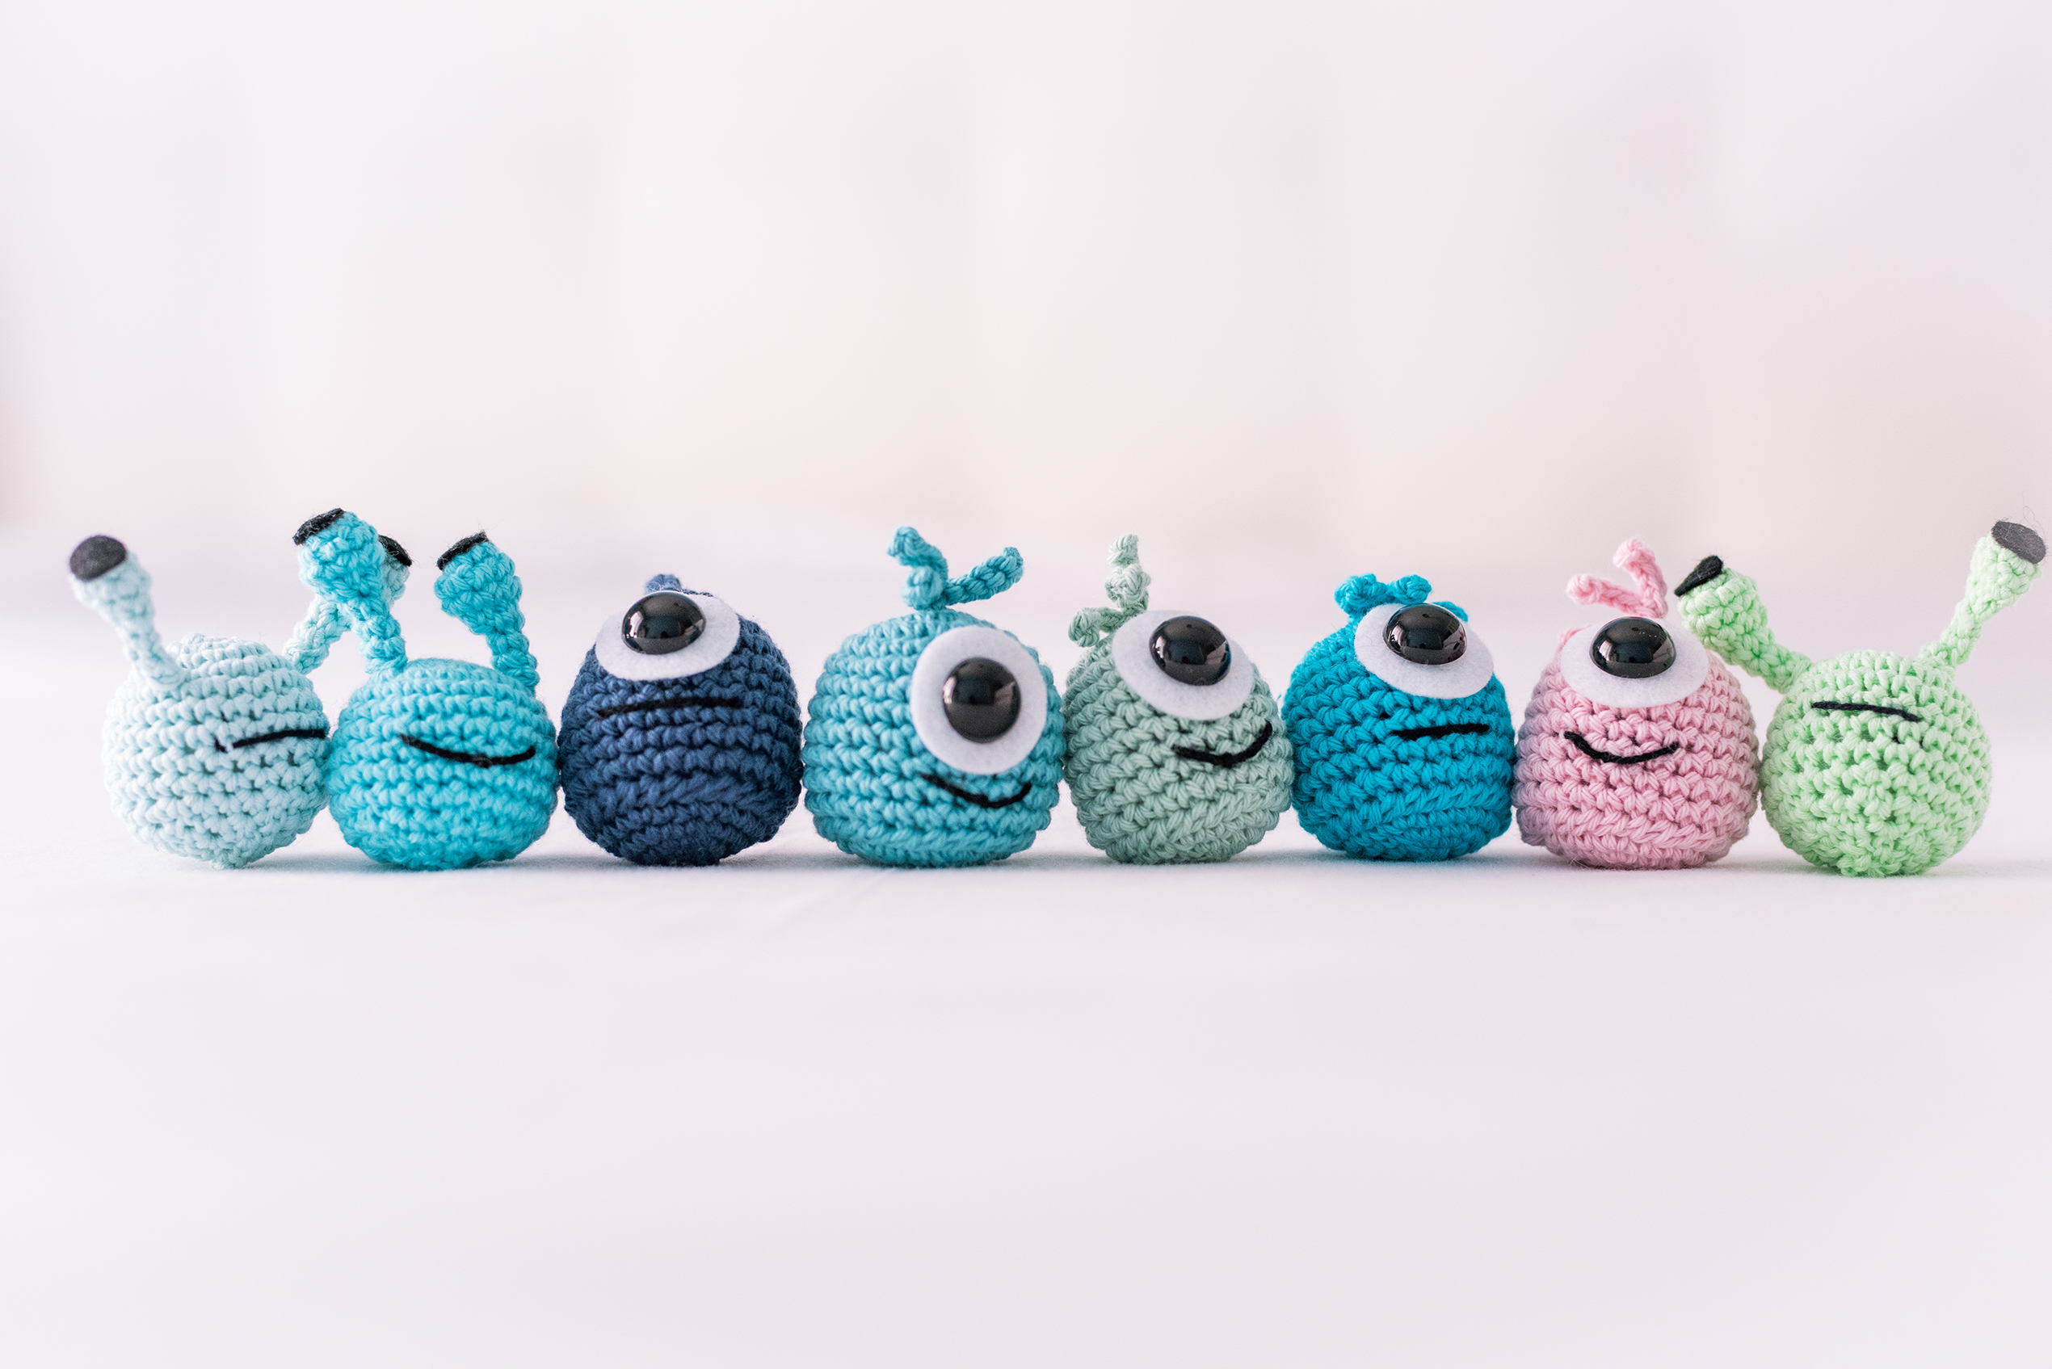
Face Image Classification
Michael Scheinfeild
04/08/2023

Slide 2
Data Set
Train: face 2429 images , non-face 4548 images (X 1.8).
Test : face 472 images , non-face 23573 images (X 49.9).
All images are 19*19 pgm.
Images will be converted to png(not lose information as jpg) to support keras read ImageGenerator (changeFormat.py). Zip Database Added to github.
The data set is imbalanced.

Slide 3
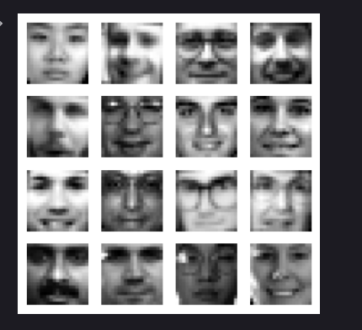
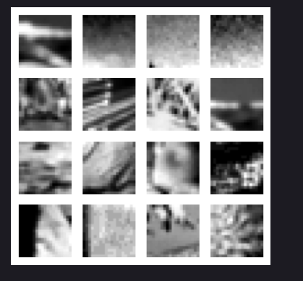
A. Train Set
Faces
Non-faces

Slide 4

Environment
Python 3.11
Initially google colab with GPU (but resources ended)
Pycharm(cpu) continued.
Tensorflow 2.13.0
Keras 2.13.1

Slide 5

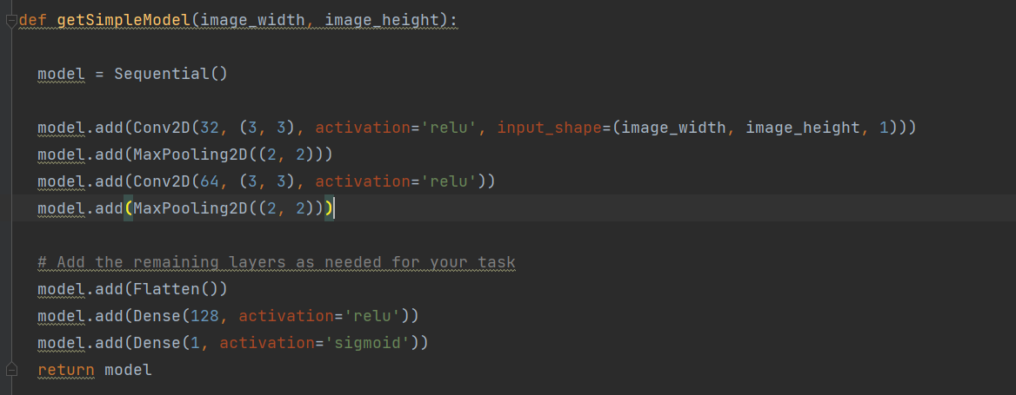
A. Small Network1
(image_width,image_height) = (19,19)

Slide 6
A. model Description
This simple model consists of two convolutional layers with 32 and 64 filters, followed by max-pooling for down sampling.
It then uses dense layers for classification, including a hidden layer with 128 neurons and a sigmoid activation function in the output layer for binary classification.
The model is suitable for basic image classification tasks and can be further customized
by adding more layers based on specific requirements.
Model compiles the with the Adam optimizer, binary cross-entropy loss function for binary classification, and accuracy as the evaluation metric to train and evaluate the model.

Slide 7
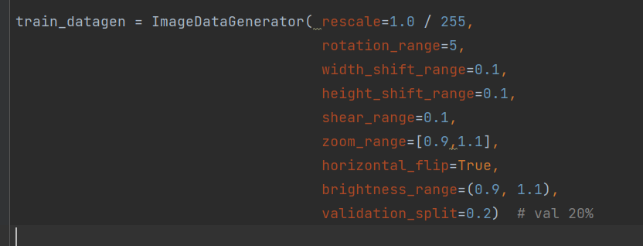
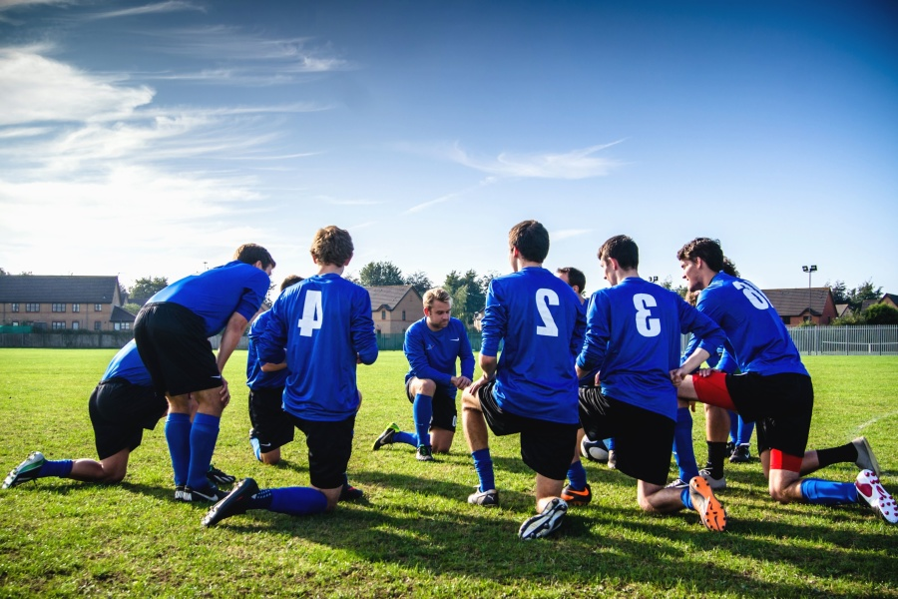
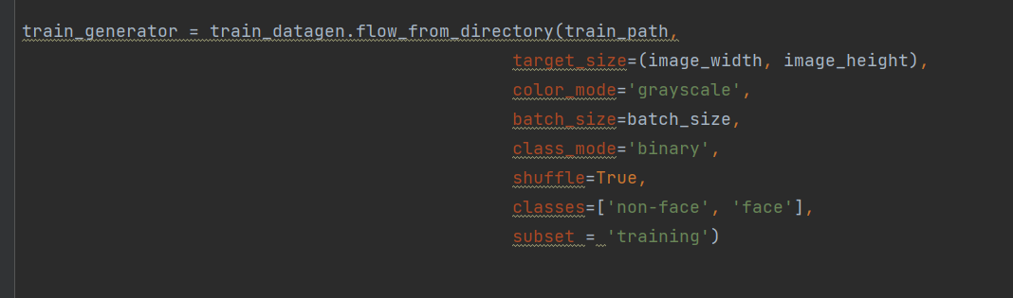
A. Model Train Data Generator
batch_size=64
(image_width,image_height) = (19,19)

Slide 8
A. Model Train Data Generator
This code prepares and augments image data for a binary classification task using the Keras
ImageDataGenerator.
The generator applies various transformations such as rotation, shift, shear,
zoom, flip, and brightness adjustments to increase data diversity and improve model generalization.
It creates a training generator from a directory with grayscale images of
size image_width x image_height (19 * 19), categorizing them into two classes: 'non-face' and 'face'.
The validation split is set to 20% to evaluate model performance.

Slide 9
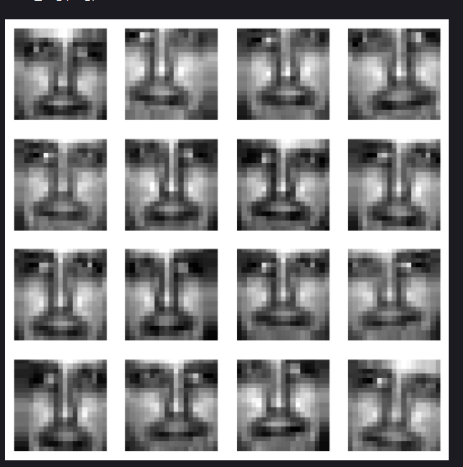
A. Train Augmentation

Slide 10
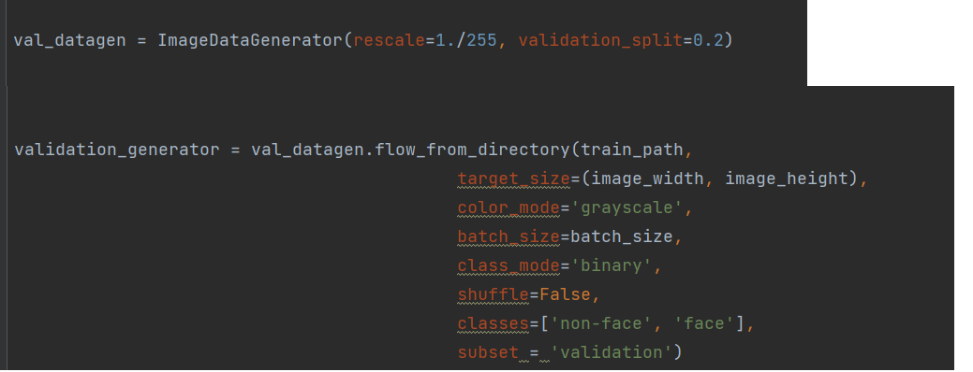

A. Model Validation Data Generator

Slide 11
A. Model Validation Data Generator
This code creates a validation data generator for a
binary classification task using the Keras ImageDataGenerator.
The main difference from the train generator is that the validation_generator does not apply
data augmentation transformations (e.g., rotation, shift, flip) to the images,
ensuring that the validation set remains consistent for performance evaluation.
It rescales the images to a range of [0, 1], converts them to grayscale,
and categorizes them into 'non-face' and 'face' classes.
The validation set size is set to 20% of the total data.

Slide 12
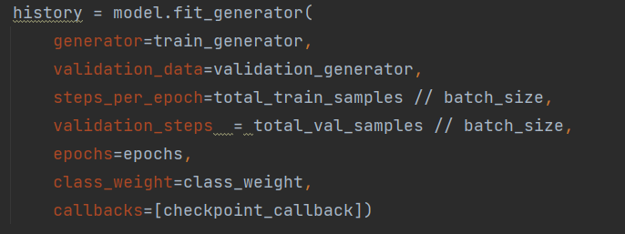
A. Model Training
# handle class imbalance
class_weight = {0: total_images / (2 * total_negative_images),
1: total_images / (2 * total_positive_images)}
class_weight {0: 0.76, 1: 1.43}
5583 train Images
1394 validation Images
TrainNetwork.py
# Define the ModelCheckpoint callback
checkpoint_callback = ModelCheckpoint(filepath=checkpoint_filepath,
monitor='val_accuracy', # Choose the validation metric to monitor
save_best_only=True, # Save only the best model weights
mode='max', # For 'accuracy', use 'max'; for 'loss', use 'min'
verbose=1)
This code defines a ModelCheckpoint callback to save the model's weights during training,
based on the highest validation accuracy achieved, ensuring that only the best model is saved.
Epochs=15

Slide 13
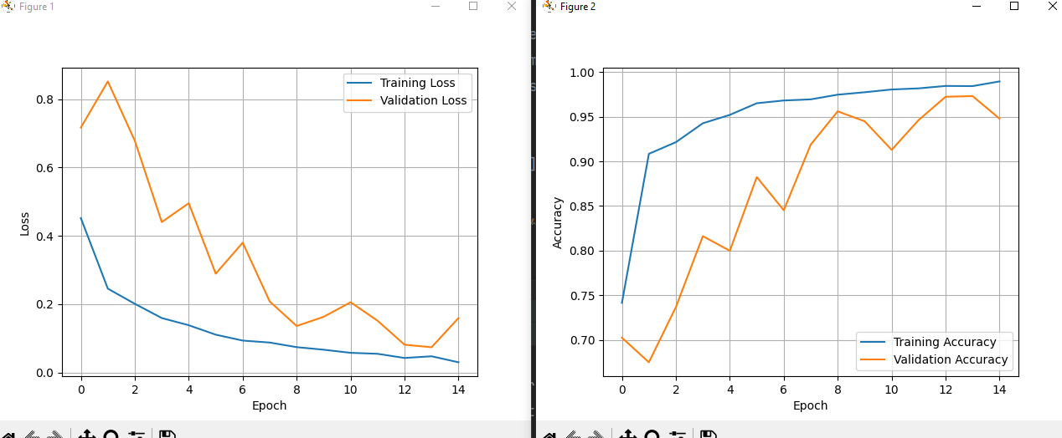
A. Small Network1 Performance
The Model Get Very High Accuracy on Train And Validation ~95%
There are some jumps during training but saved best model use check point for validation Accuracy

Slide 14
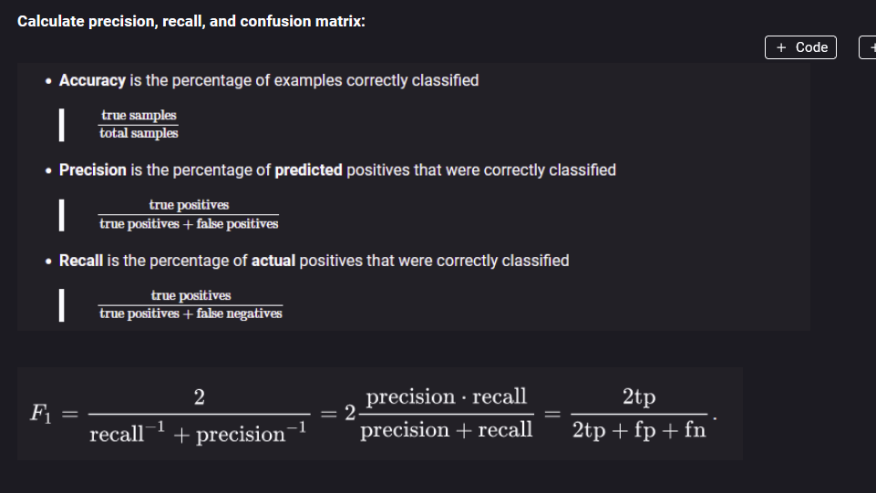
A. Evaluation metrics

Slide 15
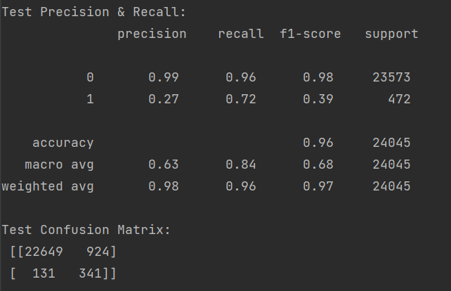
A. Small network Statistics Test
Recall is quite low 72%
also Precision is low 27%
F1 39%
* In the generator set shuffle=False

Slide 16
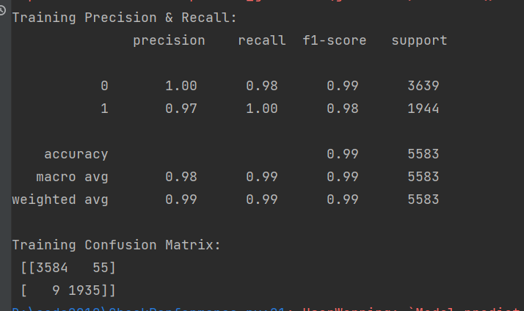
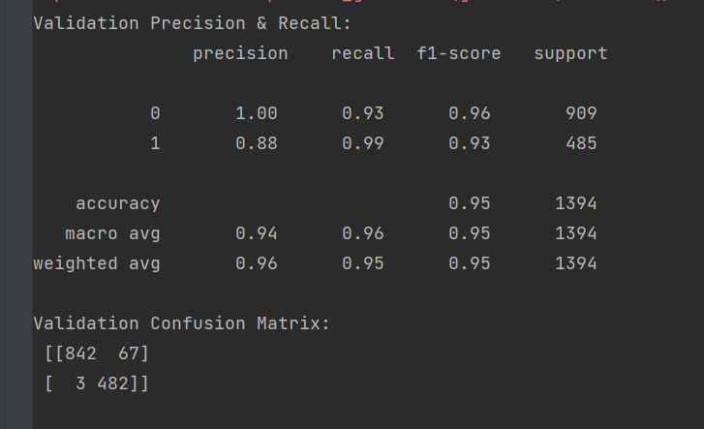
A. Small network Statistics Train Validation(Augmented)
Train
Validation
Very good Results Training and validation

Slide 17
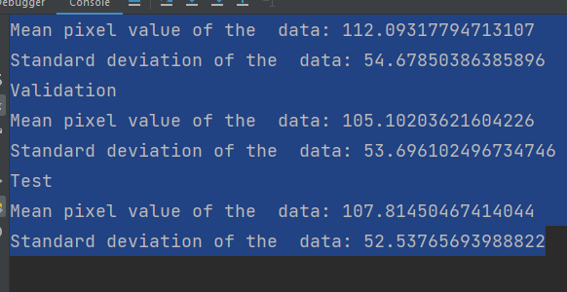
A. Training/Validation/Test statistics
As seen by result the test result worse than was from train and validation. In the short train process, no overfit seen since validation performance keep growing as train(we can add more epochs but we almost reach 100% both train and validation) . Now the task to see what is different in the Test set.
Mean, Std very close

Slide 18
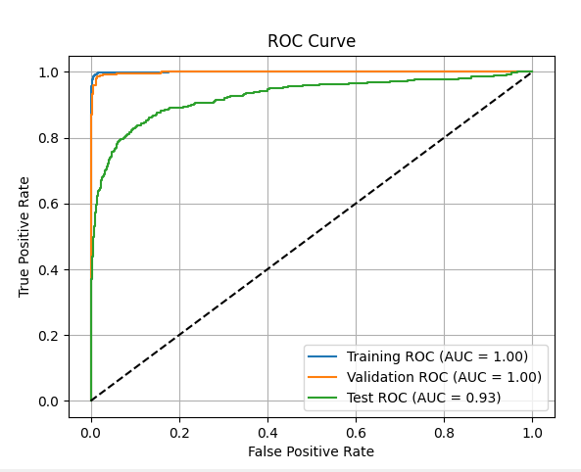
A. ROC Curve
It is hard to select threshold by validation, since all at the top.
Select by test is not recommended since it may lead to overfitting
or biased evaluation of the model's performance.

Slide 19
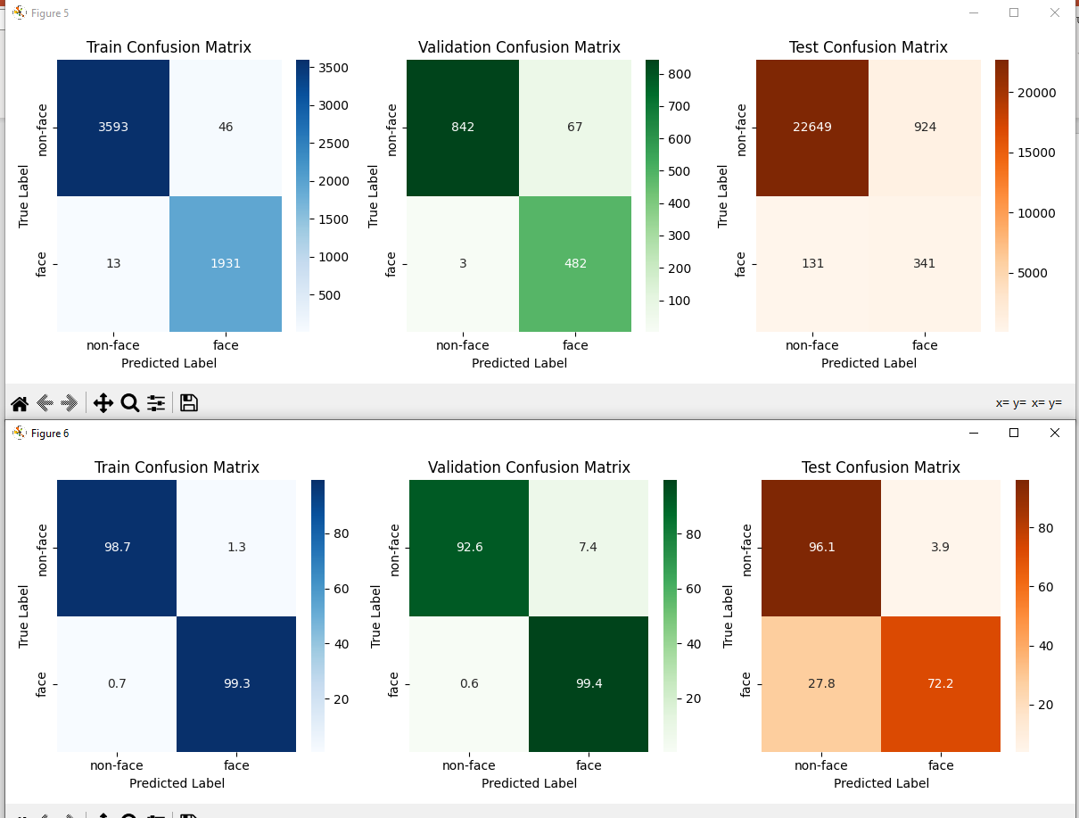
A. Confusion Matrix

Slide 20
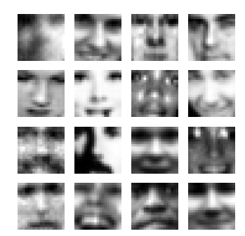
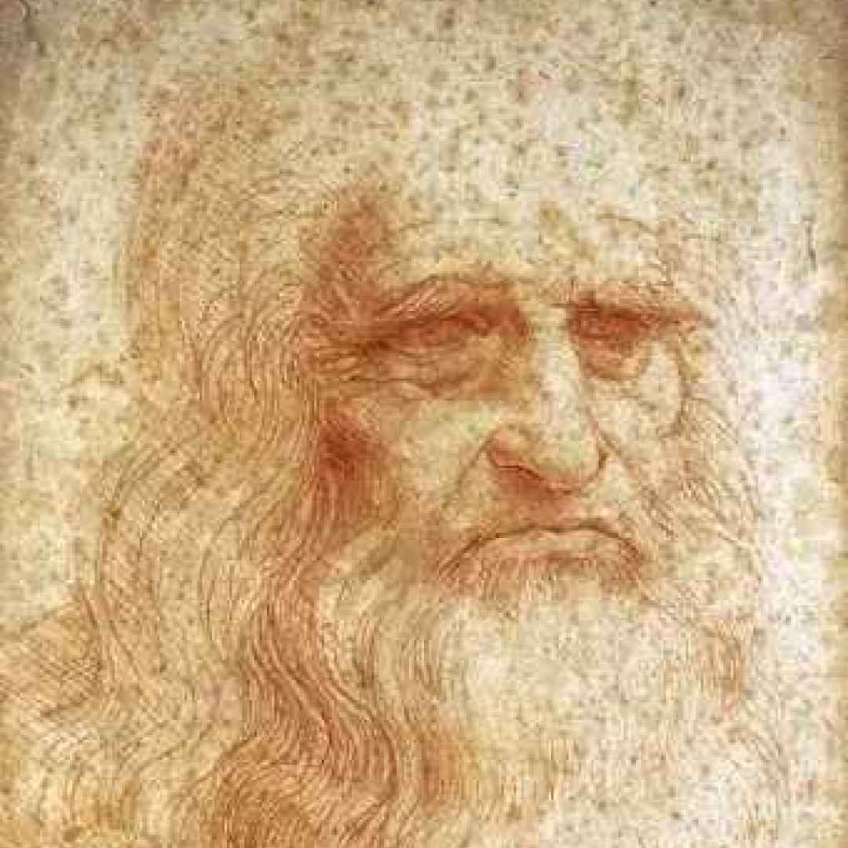
A. Images Test Set
It can be seen that test set images are
augmented with : zoom , rotation, brightness,
Shift (x,y directions)

Slide 21
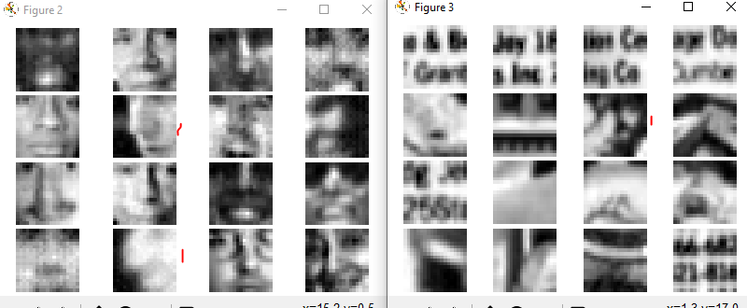
A. misclassified images
As face
Text
To evaluate this batch
changed to 1 in generator
Side faces
Face images : 2 images marked red are side face, other some very dark or zoom, which can explain misdetection.
Non Face Images: image marked red seems as face other there is some text which confuses the classifier .

Slide 22
A. Threshold Optimization
Optimize Recall use validation set:
x=0.15*np.array(vprecisions) +0.85*np.array(vrecalls)
Confusion matrix test did not improve
[23361, 212]
[ 220, 252]
previous
Test Confusion Matrix:
[22649 924]
[ 131 341]

Slide 23
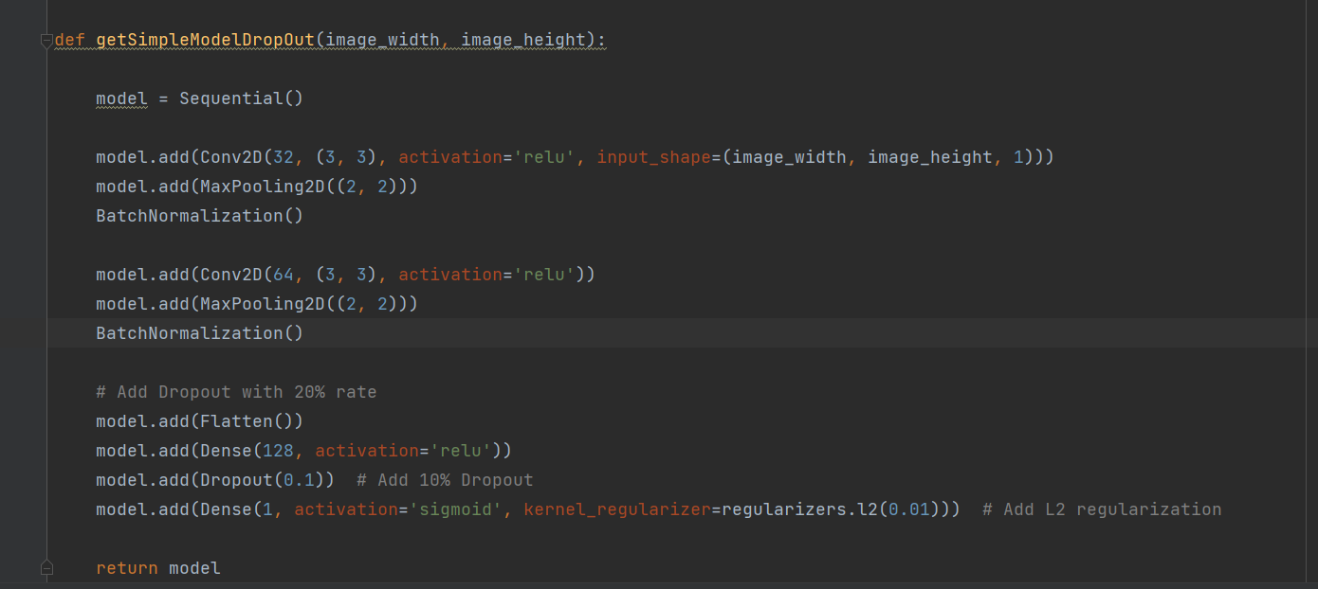
B. Small Network with stabilization
Added drop out of 20% : prevent overfitting.
Added BatchNormalization : stabilize and accelerate the training process.
Added L2 regularization : prevent overfitting.
optimizer = Adam(learning_rate=0.0005) smaller learning rate to reduce fluctuations

Slide 24
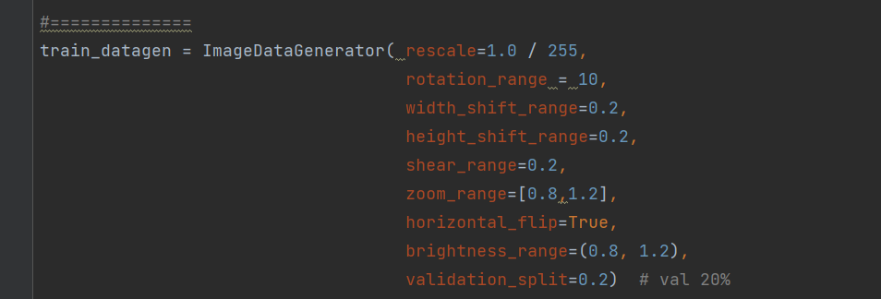
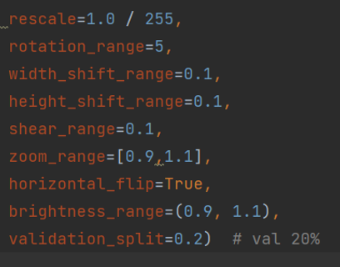
B. Increase Augmentation
A seen test set augmentation is strong so from 10% increase to 20% in several of parameters, also rotation increased.

Slide 25
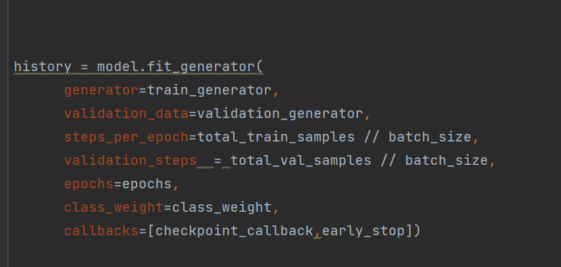
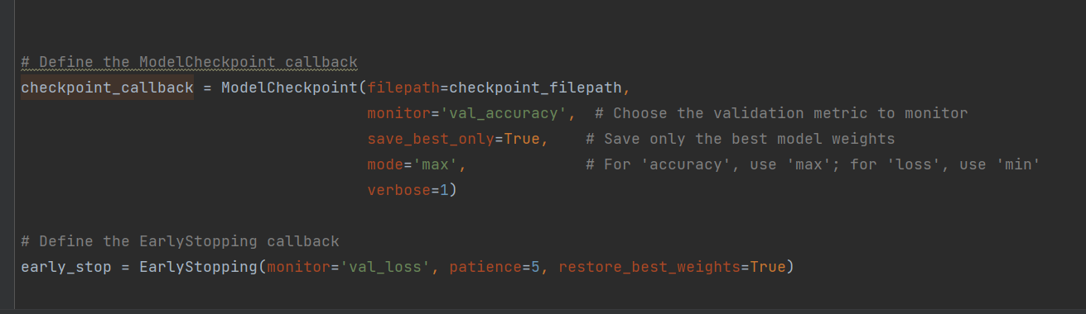
B. Best Model Save
TrainNetworkAdv.py
Checkpoint will save best weights

Slide 26
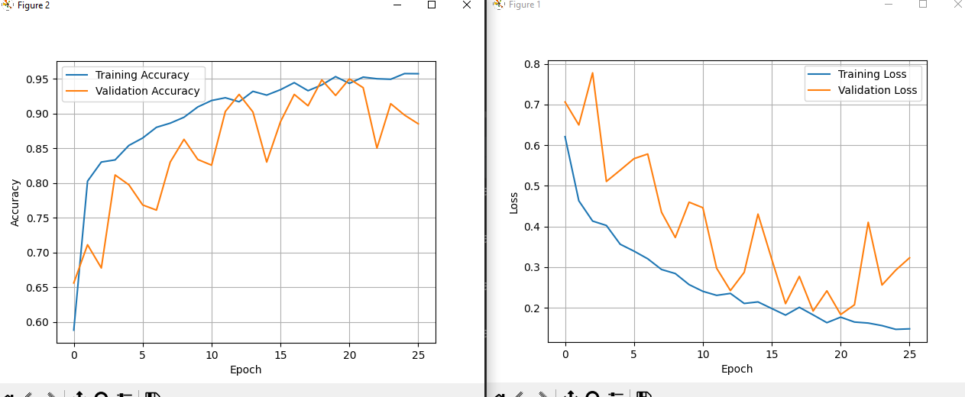
B. History Training

Slide 27
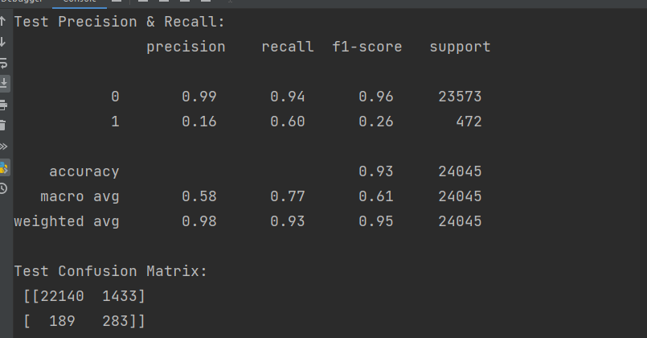
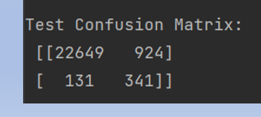
B. Small network Statistics Test(with DropOut+Norm)
Recall didn’t improved
(Default threshold 0.5)

Slide 28
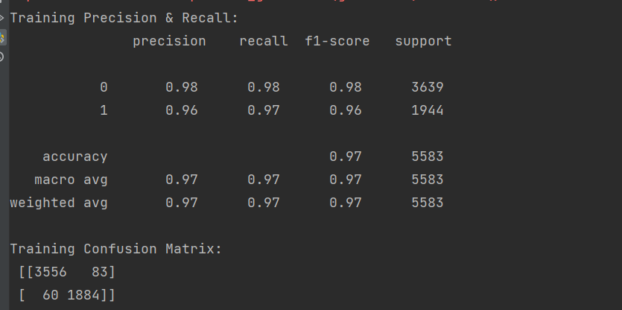
B Train result

Slide 29
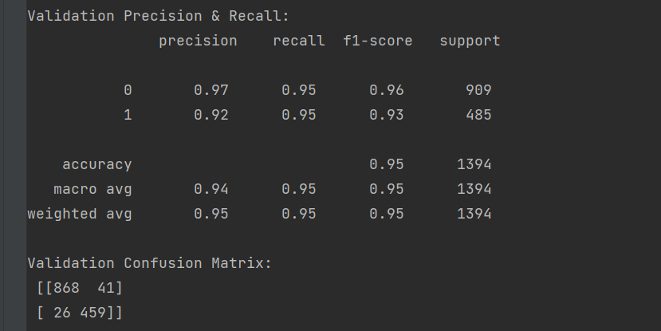
B. validation result

Slide 30
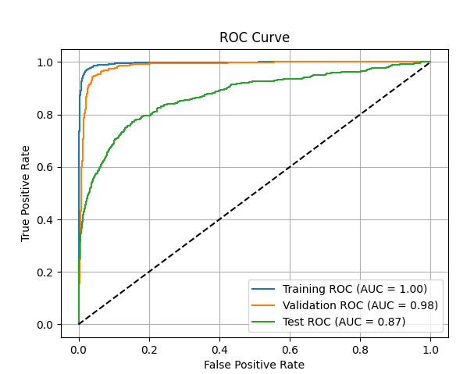
B. ROC Curve
Since added some regularization
we see Validation AUC Decreased(1.0->0.98)
we see Test AUC Decreased(0.93->0.87)
Small
network

Slide 31
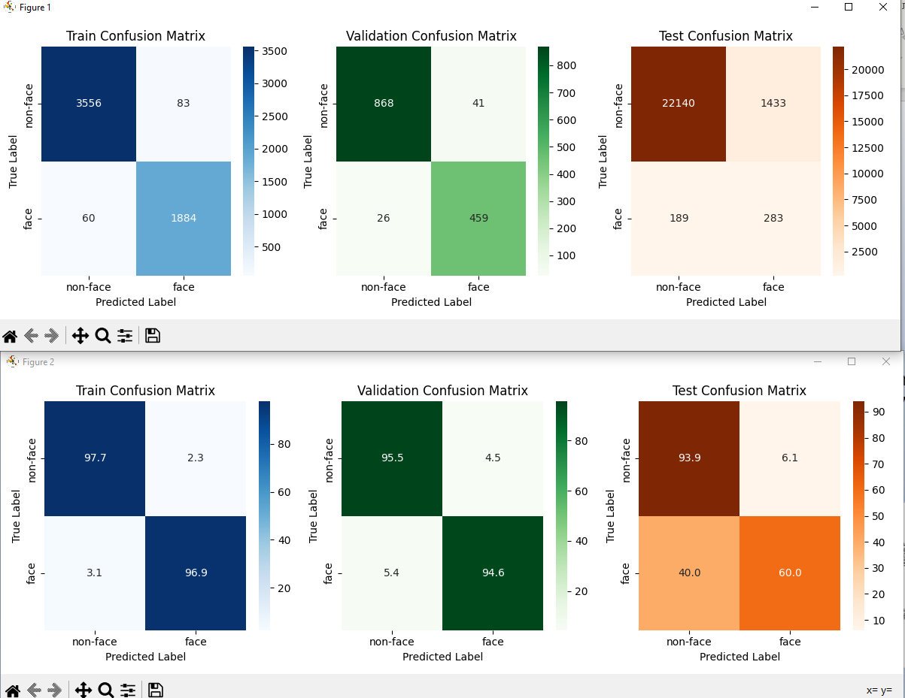
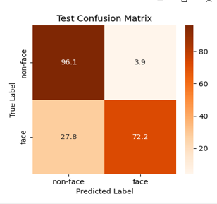
B. Confusion Matrix
Small Network with Parameters
TP decreased
from 72% to 60% in test
Small Network

Slide 32
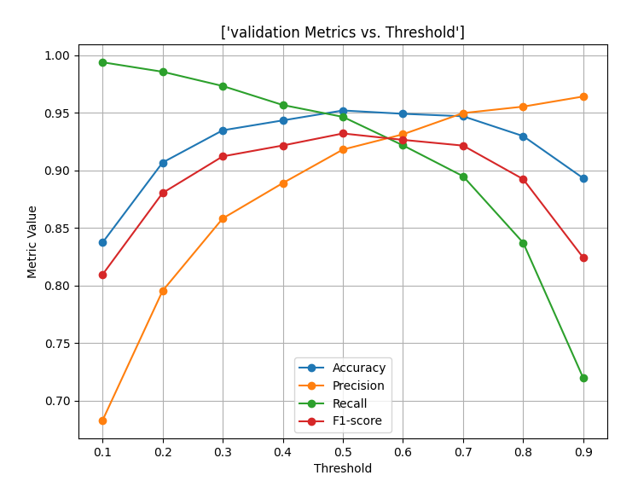
B. Tune Thresholds

Slide 33
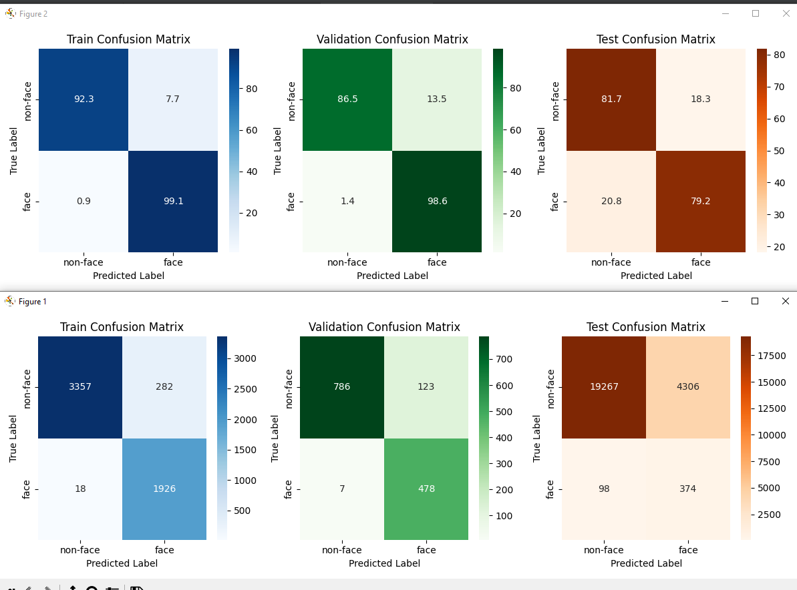
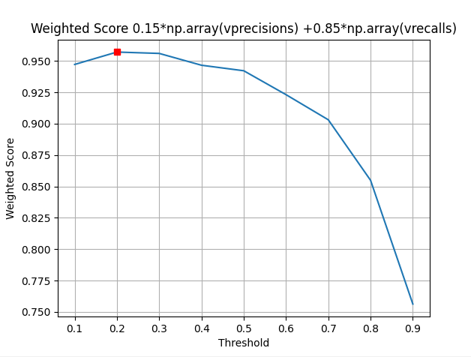
B. Selected Threshold
Threshold 0.2
Use Weighted Score
0.15*precision+0.85*recall
get optimization by Validation Group
Test Recall improved to 79%(72,60)
Test Precision Worse 8% (17%,27%)

Slide 34
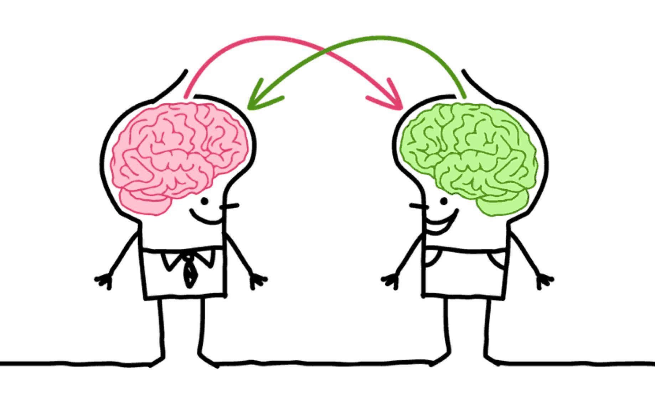
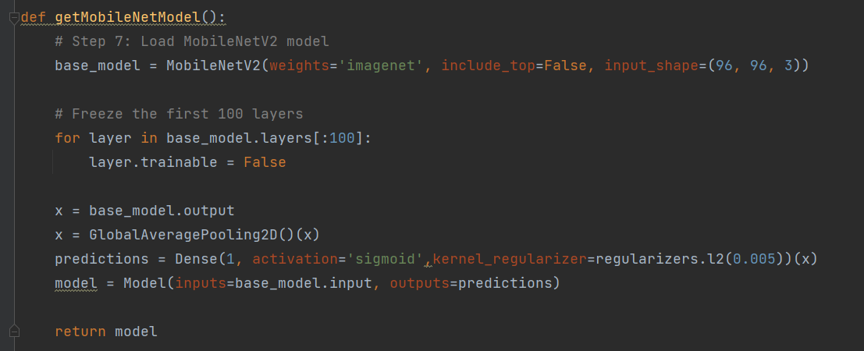
C. MobileNet Transfer Learning
Use transfer learning to get better results from pretrained networks
Images resized to 96*96*3 to fit Mobilenet format
Freeze up to Layer 100 to increase speed of Train and reduce overfit.
TrainTransfer.py

Slide 35
C. MobileNet Training
Images will be resized from 19*19*1 to 96*96*3
L2 regulizer.
Adam Optimizer.
Batch size=64.
Increased Augmentation(up to 30%).
Added checkpoint to save best weights.
Added EarlyStop for validation accuracy.
Epochs up to 50.

Slide 36
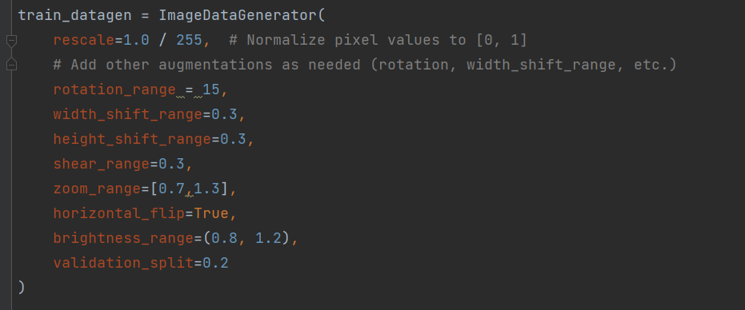
C. MobileNet generator

Slide 37
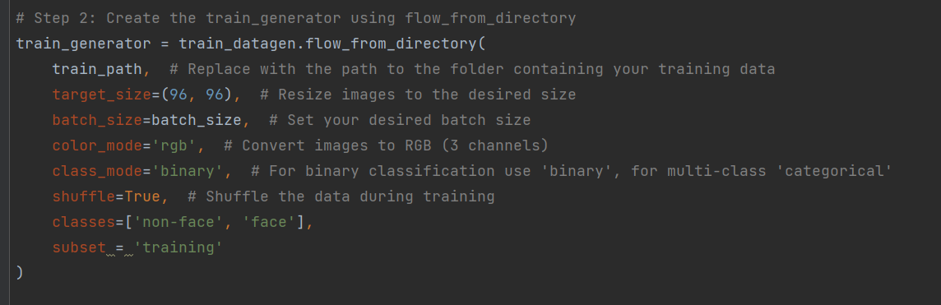
C. MobileNet generator con’td
(96,96)
rgb

Slide 38
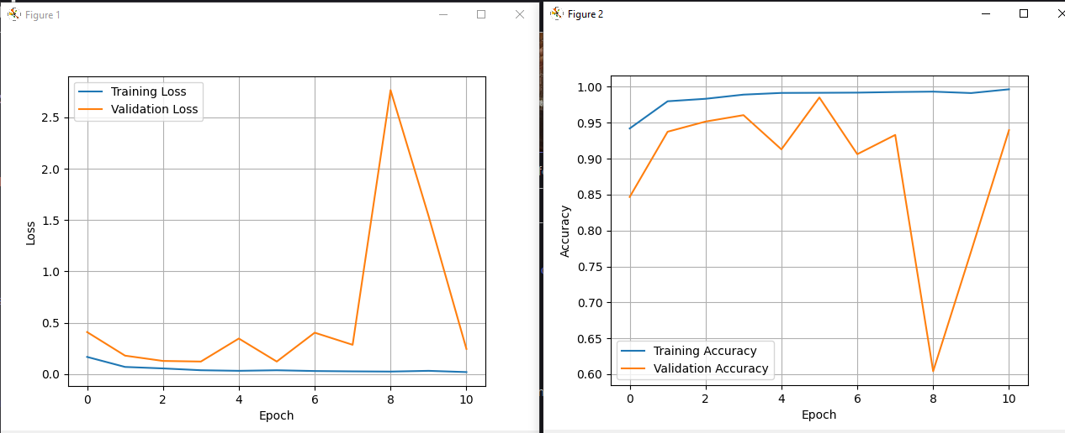
C. History MobileNet
Model stopped after 10 epchos while not improved
Epoch 11: val_accuracy did not improve from 0.98512
87/87 [=======] - 46s 532ms/step - loss: 0.0204 - accuracy: 0.9966 - val_loss: 0.2456 - val_accuracy: 0.9397

Slide 39
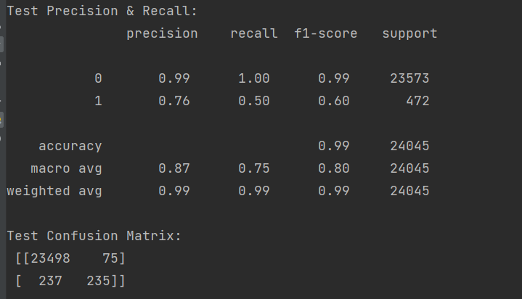
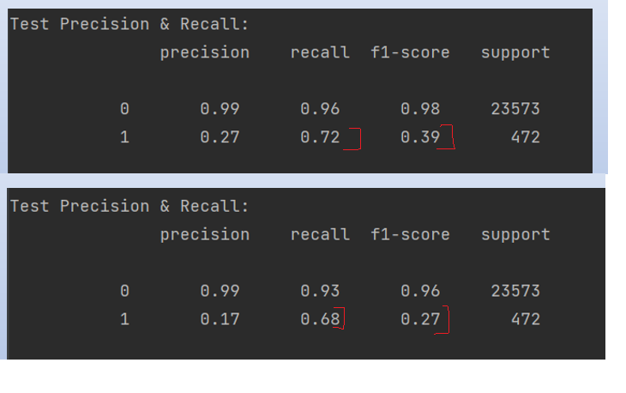
C. MobileNet Statistics Test
Network A
For Default threshold 0.5 for class faces(1)
Improved precision to 76% (27%,17%)
While Recall Decreased 50% (72%,68%)
Network B

Slide 40
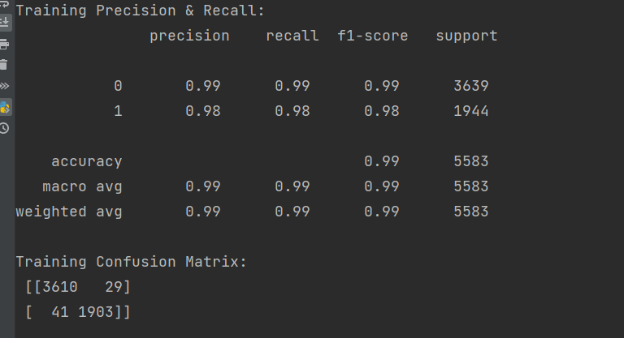
C. MobileNet Statistics Train (Threshold 0.5)

Slide 41
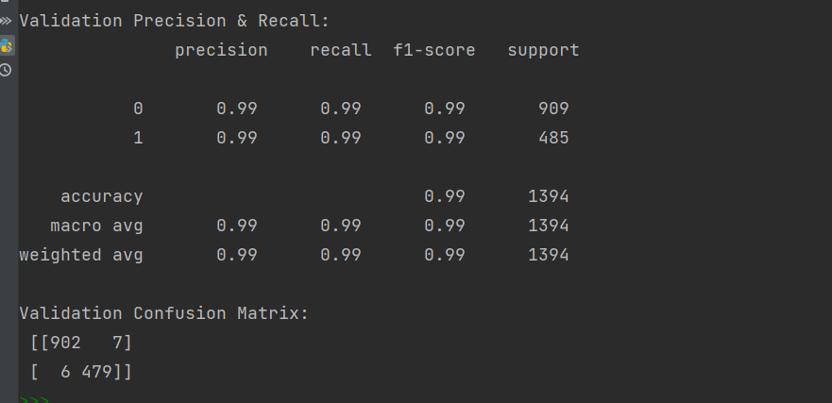
C. MobileNet Statistics Validation (Threshold 0.5)

Slide 42
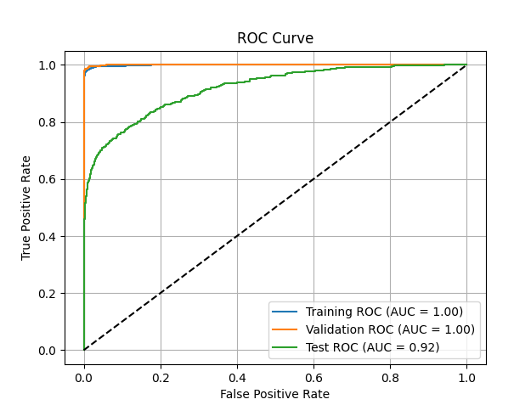
B. ROC Curve MobileNet

Slide 43
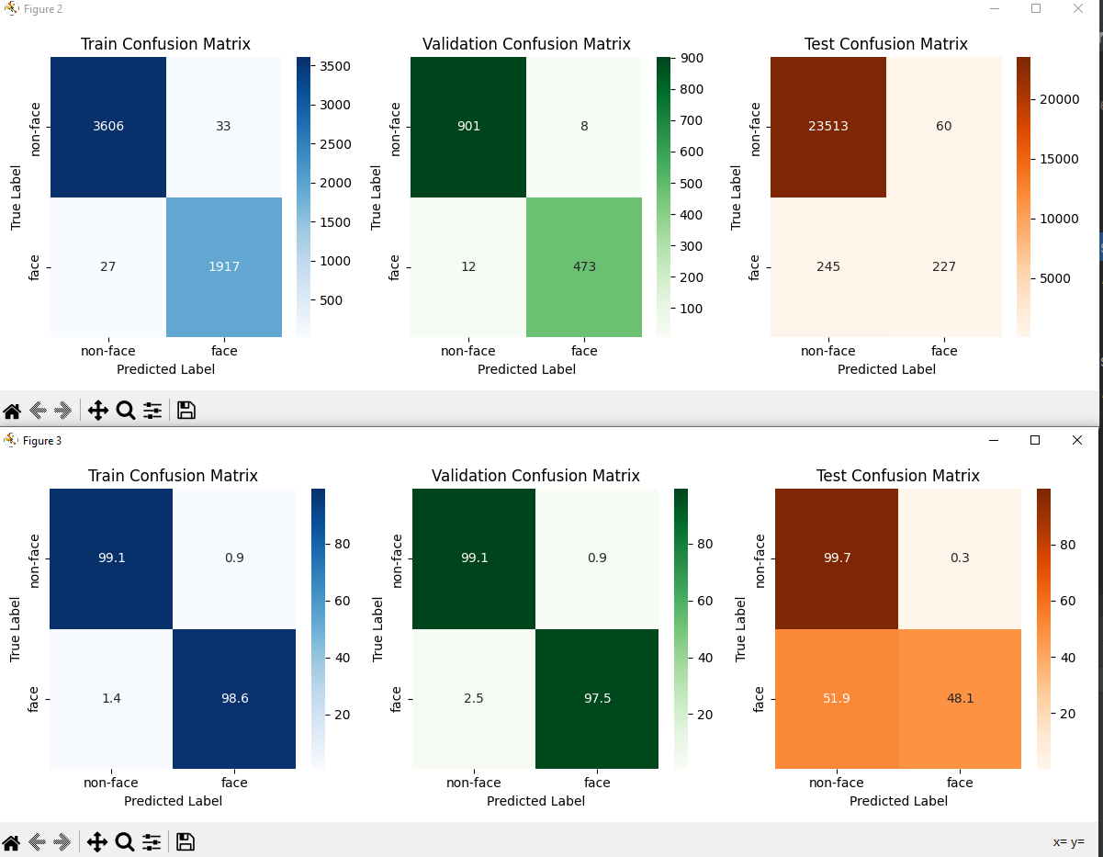
C. Confusion Matrix Test(Th=0.5)
Very Low Recall Test Set

Slide 44
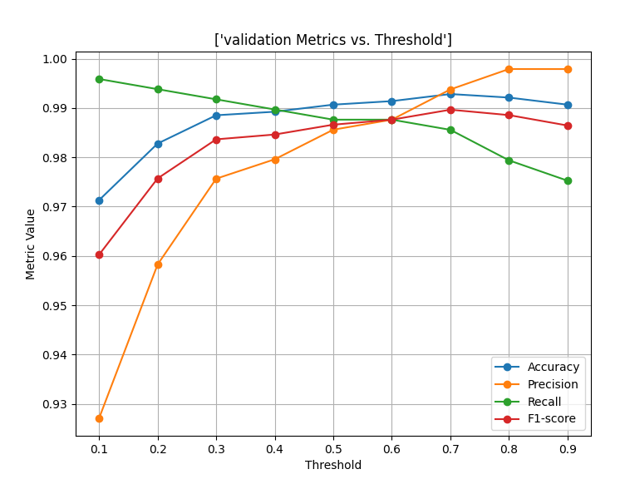
C. Validation Metrics
Several trials and sometime seen recall
Influence by threshold was minimal

Slide 45
C. Thresholds Optimizations Methods
1) Score = alpha*Recall + (1-alpha)*Precision
where alpha>0.5
2) Score = np.sqrt(tpr * (1-fpr))
Geometric mean of true positive rate and false positive rate
3) Score= N*tpr – fpr
give more weight to true positive rate.
4) Select best threshold for highegst Recall and minimum Precision.

Slide 46
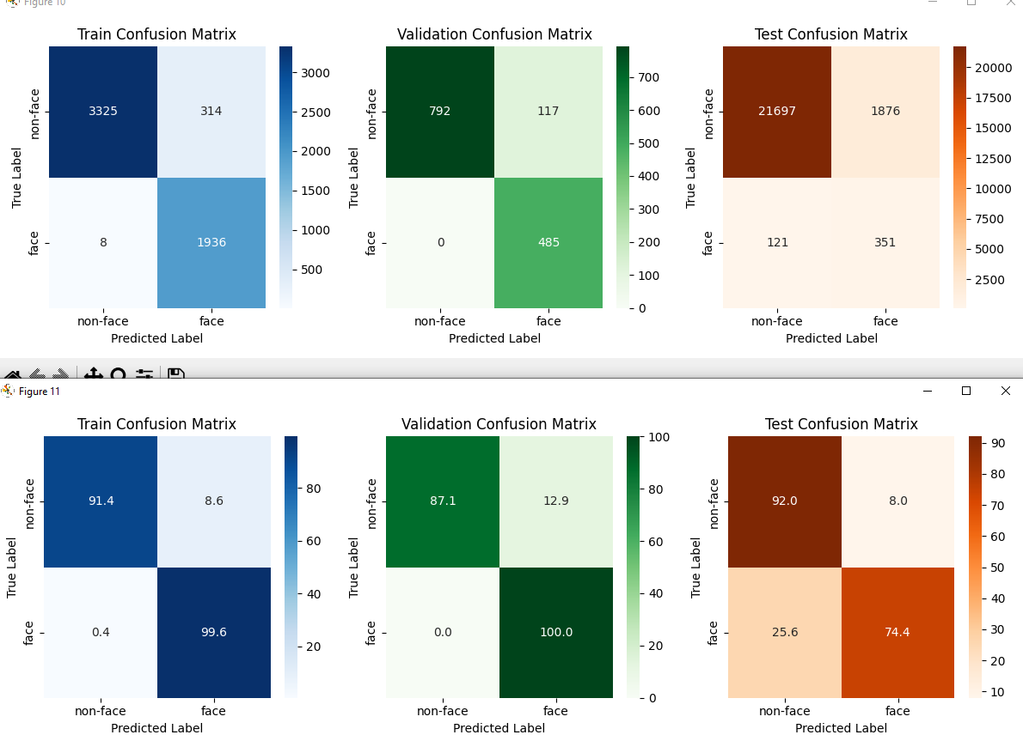
C. After Threshold Optimization (Method 4)

Slide 47


Stop
In order to compare all 3 models ,
I will load all 3 of them
Compare performance us geometric
mean of sensitivity and specificity
https://machinelearningmastery.com/threshold-moving-for-imbalanced-classification/

Slide 48

Geometric mean
Best geometric means (model1,model2,model3)

Slide 49

Detailed Performance

Slide 50
Summery and Conclusion
Designed 3 different networks :
A) Simple CNN , B) Simple CNN + DropOut +
Normalization ,
C) MobileNet.
All 3 Networks had good performance on
Train and validation.
Added Augmentation for training .
Network A has the best performance (Sensitivity=0.784 ,Specificity=0.882) this is in means of geometric mean. Our Precision will be low if we don’t care about false positives.

Slide 51
Further Steps
We can collect more data, include face side data.
Remove bad samples(some faces in folder non face etc) we can use outlier/Anomaly detection methods or just analyze misclassified samples.
We can further examine changes of test data in the augmentation and try to change augmentation.
We can try hyperparameter search : batch size, regularization, learning rate (include scheduler)
Try other methods: hugging face transformers , inception .

Slide 52
Code And Database Description
All code in https://github.com/michaelscheinfeild/FacesSmall/
changeFormat.py change pgm to png.
checkpgmma.ipynb experiments with data
TrainNetwork.py train simple network
TrainNetworkAdv.py train widh dropout+regularization
TrainTransfer.py train with mobilenet
CheckPerformance.py check performance on network A/B
CheckPerformanceMobile.py on mobileNet
CompareAll.py compare 3 networks

